Slide 1
Histogram Processing and Fundamentals of Spatial Filtering
Digital Image Processing
Dr. Muhammad Abeer Irfan
Department of Computer Systems Engineering New UET Peshawar, Pakistan
Readings: Chapter 3 (sections 3.3 and 3.4)
How to read: at least twice, once laid back, once with full focus.
1 / 41

Slide 2
Table of Content
Histogram Processing Histogram Equalization
Histogram Matching (Specification) Local Histogram Processing Fundamentals of Spatial Filtering Correlation vs. Convolution
●
●
●
●
●
●

Slide 3
Histogram Processing
●
Let r_{k}, for k=0,1,…,L-1, represent the intensities of an L-level image f(x,y).
The unnormalized histogram of f is defined as
●
h(r_{k} )=n_{k} , for k =0,1,2 ,... , L−1
where n_{k} is the number of pixels of f with intensity r_{k}.
●
The subdivisions of the intensity scale are called histogram bins.
The normalized histogram of f is defined as
●
n
k
MN MN
p (r )= ^{h(r )}
=
k
k
where as usual, M and N are the number of image rows and columns.

Slide 4
Histogram Processing
●
The sum of p(r_{k}) for all values of k is always 1:
L−1
∑ p (r_{k} )=1
k=0
The components of p(r_{k}) are the probabilities of intensity levels in the image.
Histograms are very good indicators of the image contrast:
●
●
– Low-contrast: histogram with narrow intensity range; High-contrast: histogram with broad intensity range
–

Slide 5
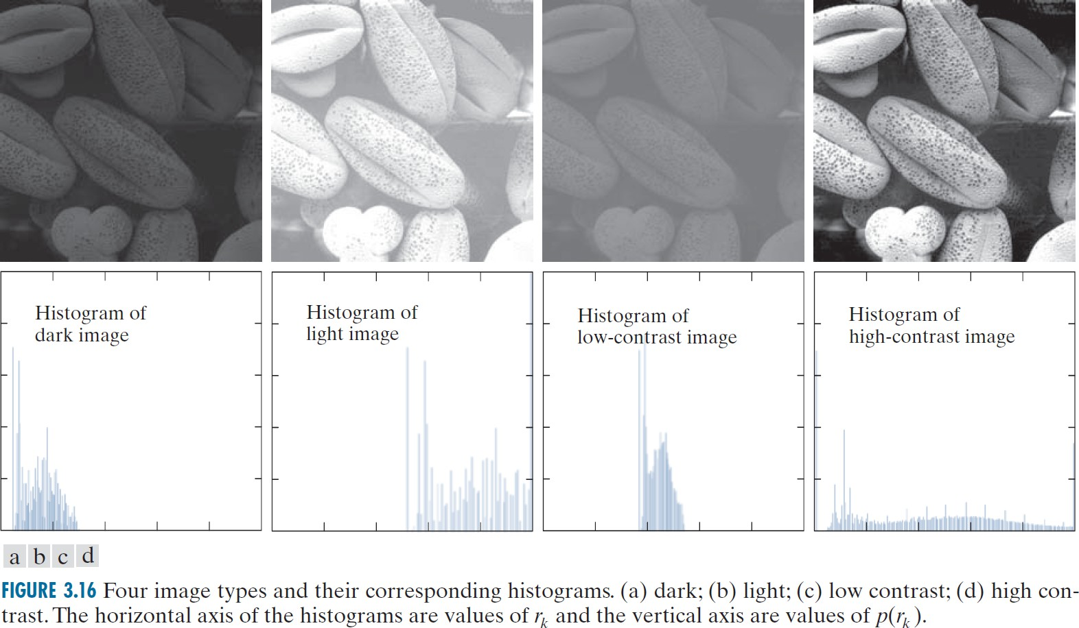
Histogram Processing
●
How to enhance the contrast in an image? Since a more even distribution in the histogram can be linked to higher contrast, it is natural to assume if a histogram is expanded to cover the full range of intensity values, the contrast is improved.
In an ideal image, every intensity level corresponds to the same number of pixels. Histogram equalization aims to do this.
●

Slide 6
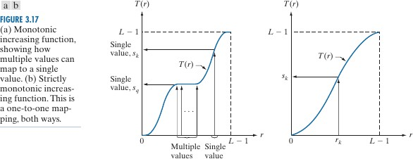
Histogram Equalization: Continuous Case
Assume a continuous range of intensity values, r in the range [0, L-1]. Let’s have a transformation (intensity mapping) function:
●
●
s=T (r ) 0≤r ≤L−1
●
Function conditions:
T(r) is a monotonic increasing function in the interval [0,L-1];
0 ≤ T(r) ≤ L-1 for 0 ≤ r ≤ L-1.
Function T is one-to-one and reversible if it is strictly monotonic (a’).
•

Slide 7
Histogram Equalization: Continuous Case
●
Condition (a) guarantees that output intensity values will never be less than the corresponding input values, preventing artifacts and intensity reversals.
Condition (b) guarantees that the range of the output intensities is the same as the input image.
Condition (a’) guarantees that the mapping function from r to s is one-to- one and reversible.
●
●

Slide 8
Histogram Equalization: Continuous Case
Let p_{r}(r) and p_{s}(s) be the Probability Distribution Functions (PDFs) on intensity values in the two images.
●
From probability theory, if p_{r}(r) and T(r) are known, and if T(r) is continuous and differentiable over the range of the values, then the PDF of the transformed variable s is:
●
p (s)= p (r )|^{dr}|
s r
ds
●
This is too general. Let’s assume a more specific function in DIP:
r
s=T (r )=( L−1)∫ p_{r} (w) dw
0
where w is the dummy integration variable.
The integral on the right is the Cumulative Distribution Function (CDF).
●

Slide 9
Histogram Equalization: Continuous Case
●
Let’s assume a more specific function in DIP:
r
s=T (r )=( L−1)∫ p_{r} (w ) dw
0
where w is the dummy integration variable.
Since PDFs are always positive, and the integral is the area under the function, the transformation function is monotonic and increasing, satisfying condition (a); Not necessarily condition (a’)
Also, for the lower limit r=0, we have s=0 and for the upper limit r=L-1, the integral adds up to 1, which makes s=L-1. This satisfies condition (b) which states the range of the output intensities should be the same as input intensities.
Now let’s drive the PDF of s.
●
●
●

Slide 10
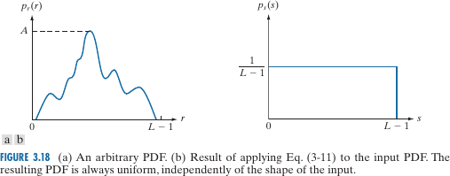
Histogram Equalization: Continuous Case
[ ]
ds
dT (r )
d
r
=( L−1)
∫
0
p (w)dw =( L−1) p (r )
dr ⁼ dr dr
r r
●
Therefore, p_{s}(s) can be derived as:
dr 1
p (s)= p (r )| |= p (r )|
|= ¹ for 0≤s≤L−1
s r
r
L−1
ds ( L−1) p (r )
r
which is a uniform distribution!
Equalization

Slide 11
Histogram Equalization: Continuous Case
⎧
2r
●
An example:
⎪
0 ≤ r ≤ L −1
p (r) =
⎨
(L −1)
2
r
⎪_{⎩0}
else
●
Then we have:
r
r
2 w
( L−1)
_{r}2
∫
∫
2 ^{r}
s=T (r )=(L−1) P (w)dw=(L−1)
dw =
∫
0
w dw =
r
2
L−1
L−1
0
0
●
Therefore:
^{ds} = T ' (r) =
2r
dr ₌ L −1
ds 2r
2r L −1 ₌ 1
ds (L −1)² 2r L −1
dr
L −1
●
And finally:
p (s) = p (r) ^{dr} =
s r

Slide 12
Histogram Equalization: Discrete Case
●
For discrete values, we have probabilities and summations, instead of probability densities and integrals.
We defined the normalized histogram for an image of size M-by-N and for
n_{k} as the number of pixels that have intensity r_{k} as:
●
n
p (r )=
k
r k
MN
●
The discrete transformation can be defined as:
k
∑
j=0
L−1
MN
k
∑
j=0
s_{k} =T (r_{k} )=(L−1)
p (r )=
n , for k =0,1,2 ,... , L−1
r j
j
where L is the number of intensity levels.
The procedure is called a histogram equalization or histogram linearization transform.
●

Slide 13
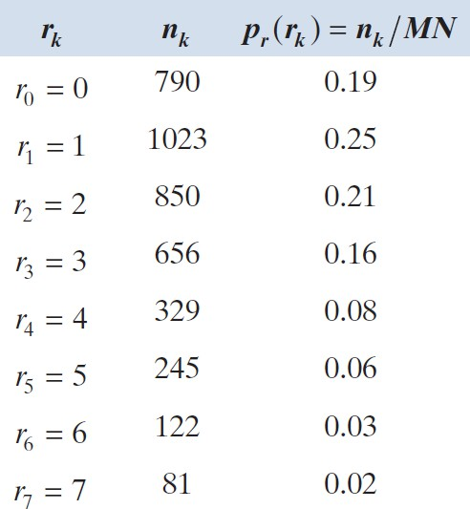
Histogram Equalization: Discrete Case
●
Example: a 64-by-64, 3-bit (L=8) image, with the provided histogram.
●
Let’s define s_{k} as:
k
s_{k} =( L−1)∑ p_{r} (r _{j} ), for k =0,1 , ... , L−1
j=0
●
We will have:
s₀=7 p_{r} (r₀)=1.33
s₁=7 ( p_{r} (r₀)+ p_{r} (r₁))=3.08
s₂=7( p_{r} (r₀)+ p_{r} (r₁)+ p_{r} (r₂))=4.55
s₃=...

Slide 14
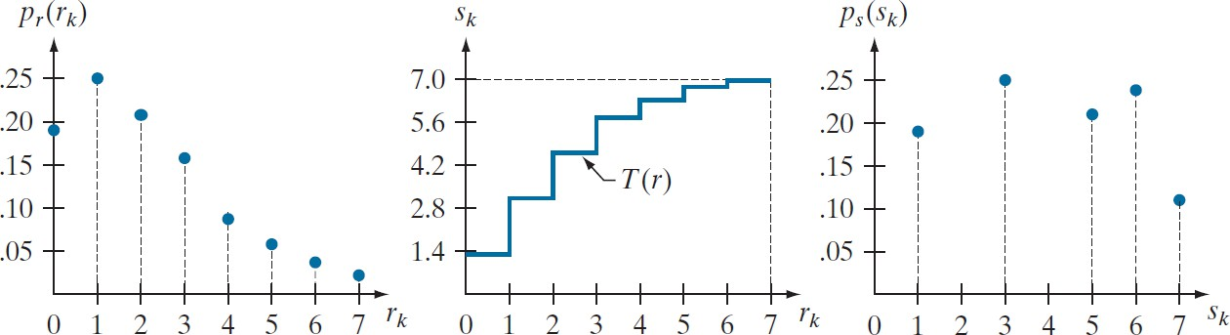
Histogram Equalization: Discrete Case
s₀ = 1.33 →1
s₁ = 3.08 → 3
s₄ = 6.23 → 6
s₅ = 6.65 → 7
●
Fractional s values need to be rounded to the closest integer value in the range [0,7].
s₂ = 4.55 → 5 s₆ = 6.86 → 7
s₃ = 5.67 → 6 s₇ = 7.00 → 7

Slide 15
Histogram Equalization: Discrete Case
●
Because a histogram is an approximate PDF, and no new intensity values are created in the process, perfectly flat histograms are rare in practical applications.
●
Unlike the continuous case, it cannot be proved than the discrete histogram equalization results in a uniform histogram.
●
However, histogram equalization is fully automatic, without the need for any parameter specification.
●
The inverse transformation from s back to r is:
−1
r_{k} =T (s_{k} )
●
This transformation satisfies two initial conditions, if all intensity levels are present in the input image. Or in another word, none of the histogram bins of the image are empty.

Slide 16
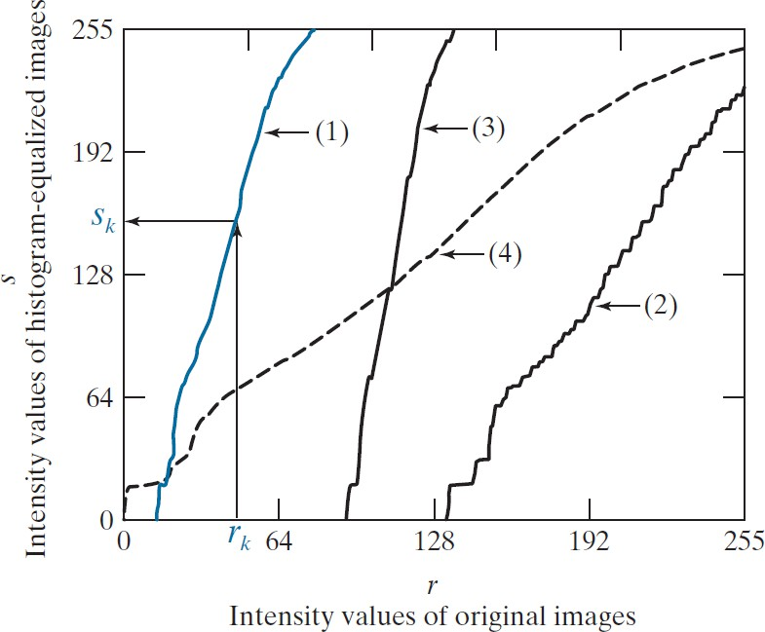
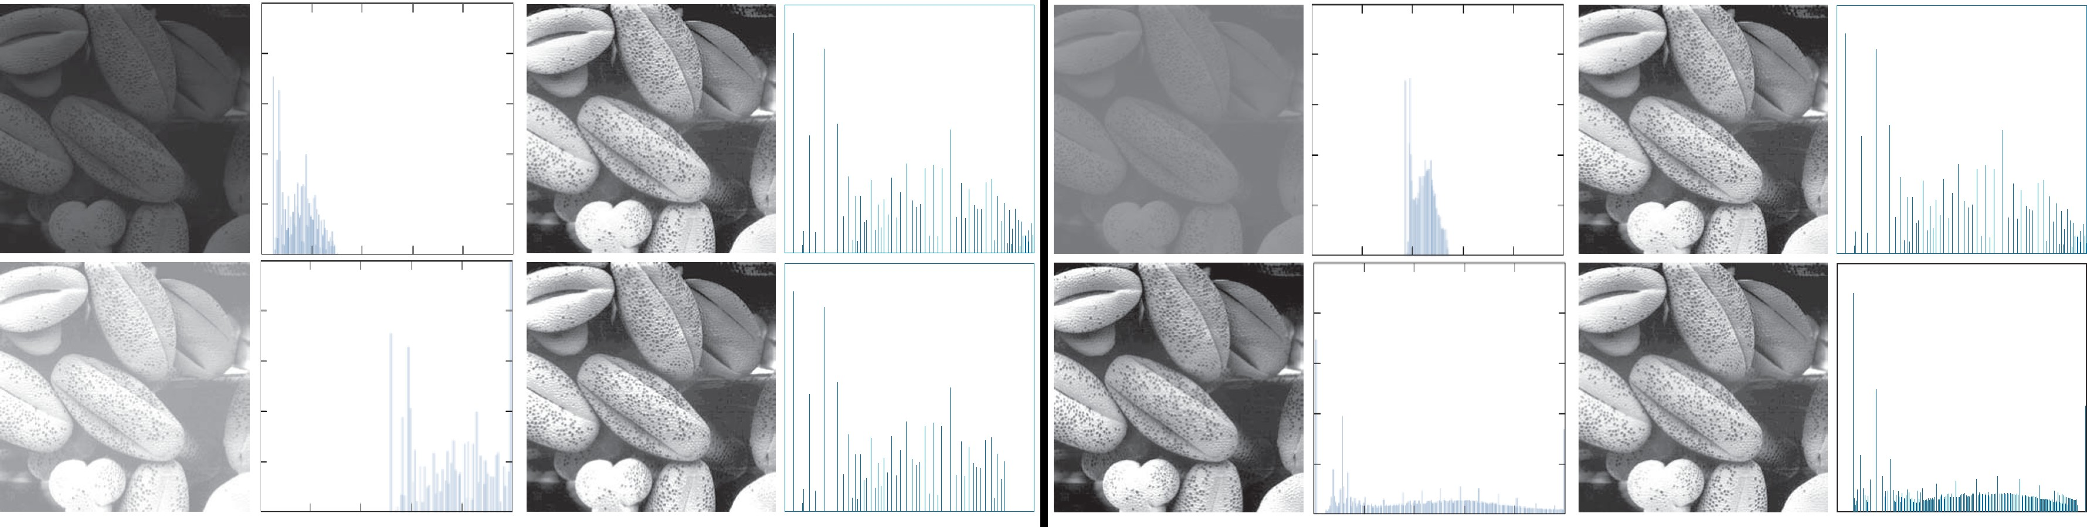
Histogram Equalization: Discrete Case
●
Advantage: no parameters needed.
●
Conceptually optimal

Slide 17
Histogram Matching (Specification)
●
Histogram equalization produces a transformation function to generate an output image with a uniform histogram.
●
This is not always ideal. What if we want the specify the shape ourselves?
●
The method to achieve this is called histogram matching or histogram specification.
●
Let’s assume the continuous case again.
Assume an image with PDF p_{r}(r) that we want to transform to an image with PDF p_{z}(z).
●
●
Here p_{z}(z) is not uniform.

Slide 18
Histogram Matching: Continuous Case
●
Let s be a random variable defined as before:
r
s=T (r )=( L−1)∫ p_{r} (w) dw
0
where w is the dummy variable of integration.
●
Let’s do the same based on variable z:
z
G( z)=(L−1)∫ p_{z} (v )dv=s
0
where v is the dummy variable of integration.
●
Combining the two equations, we have:
G ( z)=s=T (r )⇒ z=G⁻¹ (s)=G⁻¹ [T (r )]

Slide 19
Histogram Matching: Continuous Case
●
The procedure can be summarized as:
Obtain p_{r}(r) from the input image;
Use the specified PDF, p_{z}(z), to obtain function G(z);
Compute the inverse transformation z=G⁻¹(s), which is a mapping from s to z.
Obtain the output image by first equalizing the input (r to s). Then, for each pixel s in the equalized image perform the inverse mapping z=G⁻¹(s) to obtain the corresponding pixel in the output image.
●
In general, finding the analytical expression for G⁻¹ is not a trivial task. In the discrete case this is not a problem.

Slide 20
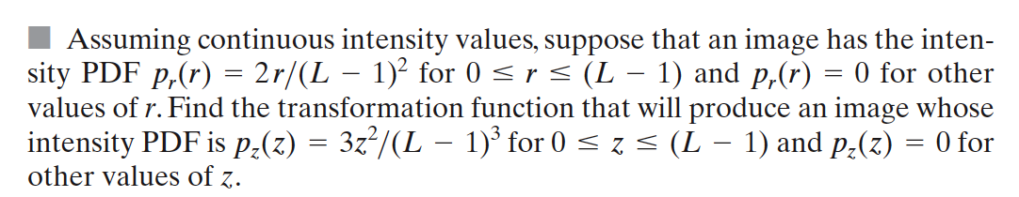
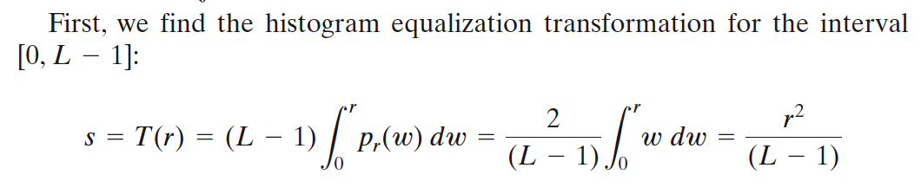
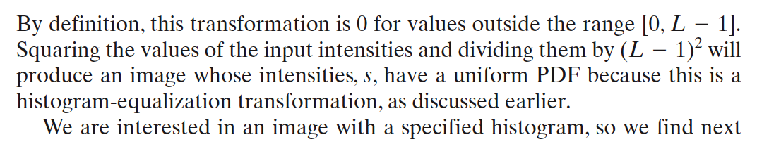
Histogram Matching: Continuous Case

Slide 21
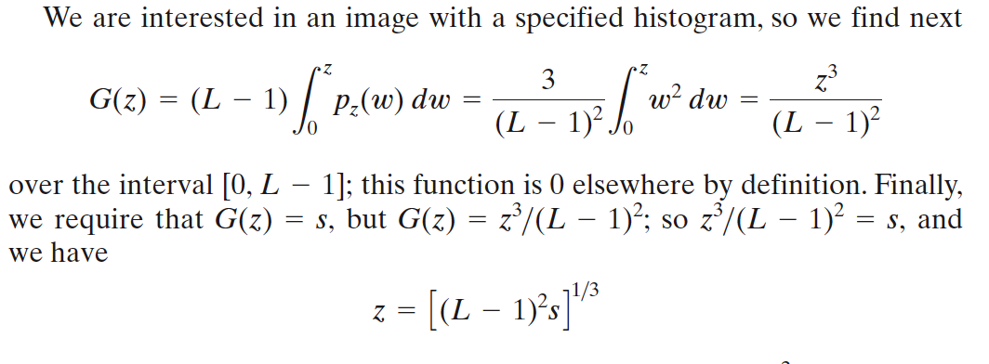
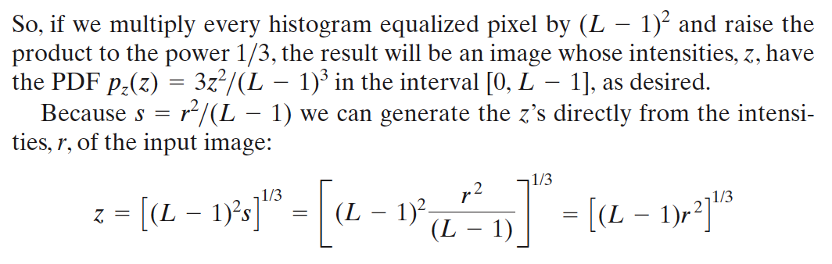
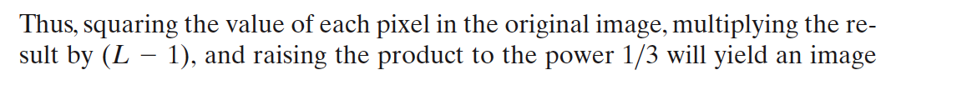
Histogram Matching: Continuous Case

Slide 22
Histogram Matching: Discrete Case
●
In the discrete case, first histogram equalization transformation from r to s
is performed:
k
s_{k} =T (r_{k} )=( L−1)∑ p_{r} (r _{j} ) for k =0,1,2 , ... , L−1
j=0
●
Similarly given a specific value of s_{k}, for a value of q we find G(z_{q}) such
that:
q
G (z_{q} )=( L−1)∑ p_{z} ( z_{i})=s_{k}
i=0
where p_{z}(z_{i}) is the i’th value of the specified histogram.
The desired value of z_{q} is computed from the inverse transform:
●
−1
z_{q}=G (s_{k} )
●
In practice, no need to compute the inverse of G. Since the intensity levels are integers, it is simple to compute all the possible values of G using the second equation for q=0,1,2,….,L-1. These values are rounded to their nearest integer value and stored in a lookup table. Given a particular value of s_{k}, we look for the closest match in the table.
20 / 41

Slide 23
Histogram Matching: Discrete Case
●
To summarize:
Compute histogram p_{r}(r) of the input image, and then histogram-
equalize it to the uniform histogram. Round the resulting values, s_{k}, to the integer range [0,L-1];
Compute all values of function G(z_{q}) for q=0,1,2,…,L-1, round the
values to integers in range [L-1], and store them in a lookup table.
For every value of s_{k}, k=0,1,2,…,L-1, use the stored value of G from
Step 2 to find the corresponding value of z_{q} so that G(z_{q}) is closest to s_{k}. When more than one value of z_{q} gives the same match, choose the smallest value by convention.
Form the histogram-specified image by mapping every equalized pixel with value s_{k} to the corresponding pixel with value z_{q} in the histogram-
specified image, using the mappings found in Step 3.

Slide 24
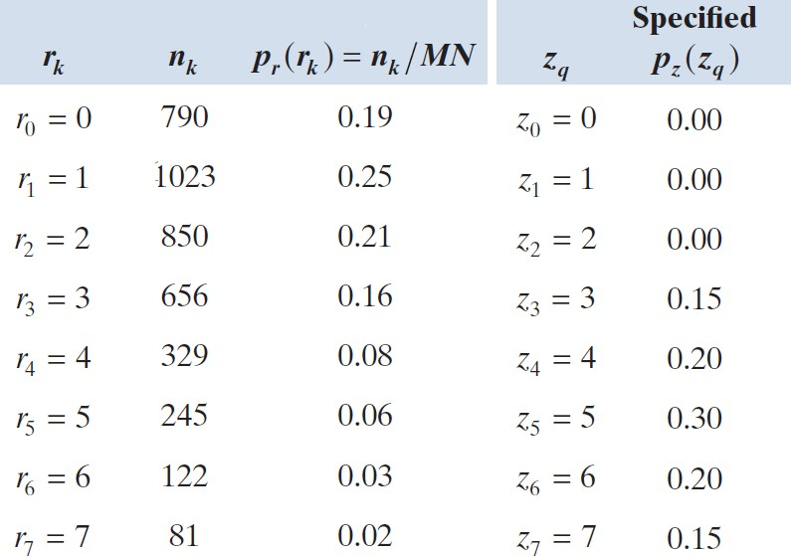
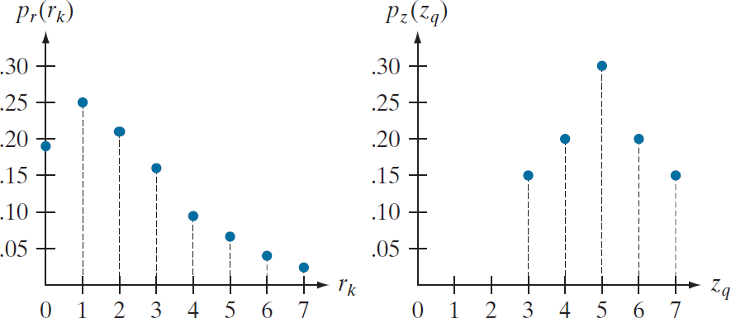
Histogram Matching (Specification)
●
Example: same 64-by-64, 3-bit (L=8) image as the previous example.

Slide 25

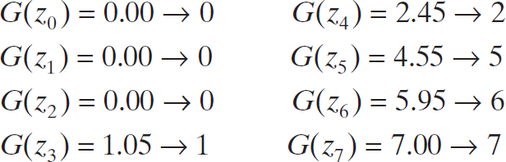
Histogram Matching (Specification)
●
The first step is to compute the rounded histogram-equalized values, as
we did in the previous example:
s₀ = 1.33 →1
s₁ = 3.08 → 3
s₄ = 6.23 → 6
s₅ = 6.65 → 7
s₂ = 4.55 → 5 s₆ = 6.86 → 7
s₃ = 5.67 → 6 s₇ = 7.00 → 7
●
Then, we compute the values of G(z_{q}) using the values of p_{z}(z_{q}):
●
These values are then rounded to their nearest integer values:

Slide 26
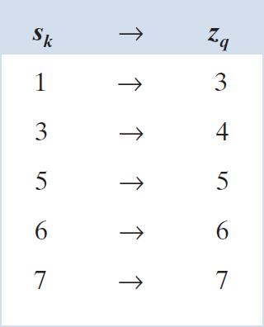
Histogram Matching (Specification)
●
The first three values of G are equal, so it is not strictly monotonic, therefore condition (a’) is violated.
Given this, we follow step three of the histogram matching approach which states we need to find the smallest value of z_{q} so that the value G(z_{q}) is
the closest to s_{k}. This is done for every value of
s_{k} to create the required mapping from s to z.
For example, for s₀=1, we have G(z₃)=1 which is a perfect match, which means that every pixel in
the histogram-equalized image with value of 1, is mapped to a pixel with value 3 in the histogram- specified image.
●
●

Slide 27
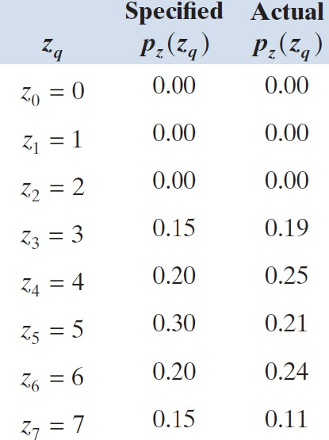
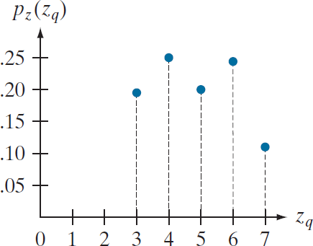
Histogram Matching (Specification)
●
The final step is to use the computed mappings to map every pixel in the histogram-equalized image into the corresponding pixel in the newly created histogram-specified image.
The final result does not match the specified histogram exactly, however the general trend was achieved.
Obtaining the histogram-equalized image is not necessary. We can list the mappings from r to s, and from s to z, and then use these mappings to map the original pixels directly into the pixels of the histogram-specified image.
●
●

Slide 28
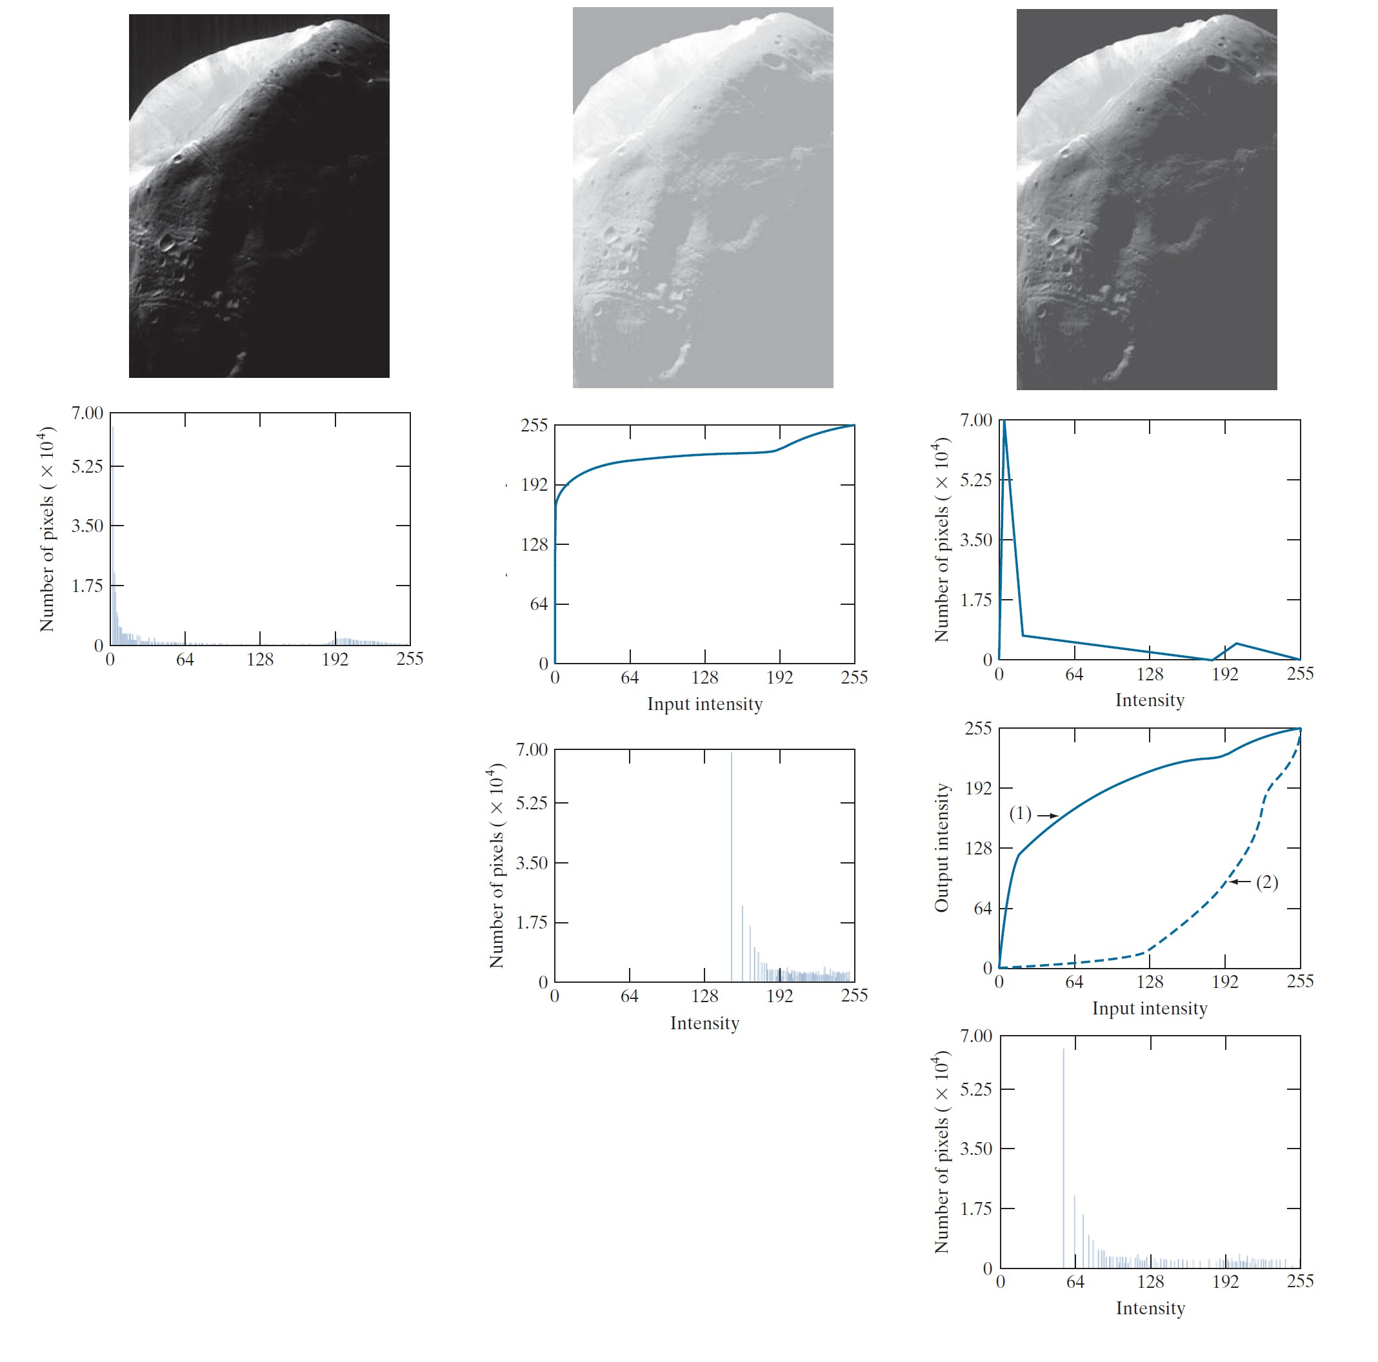
Histogram Matching vs. Histogram Equalization
•
Left:
Input image
Initial Histogram
•
Middle
Histogram equalization result
Histogram equalization transformation
Histogram of histogram equalized image
•
Right
Histogram specification result
Specified histogram
Transformation G(z_{q}), labeled (1), and G⁻¹(s ) labeled (2)
k
Histogram of the histogram- specified image

Slide 29
Global Histogram Processing
●
Both histogram equalization and histogram matching are global histogram processing methods, since pixels are modified based on the intensity distribution of the entire image.
If the aim is to enhance details over small areas of an image, they fail, since the number of pixels in small areas have less significant impact in the computation of global transformations.
To remedy this, we can devise transformations based on the intensity distribution of pixel neighborhoods.
For this, we define a neighborhood, move its center from pixel to pixel in a raster scanning scheme, and at each location, histogram equalization or matching is performed and a new mapped intensity is computed for the center pixel of the neighborhood.
Since only one row or column of the neighborhood changes in a one-pixel translation, the histogram from the previous step can be updated so there is no need for full calculation of the histogram in each neighborhood.
●
●
●
●

Slide 30

Global vs. Local Histogram Processing
●
Example of global vs. local (3-by-3 neighborhood) histogram equalization in a noisy image, with very faint shapes in the dark regions.

Slide 31
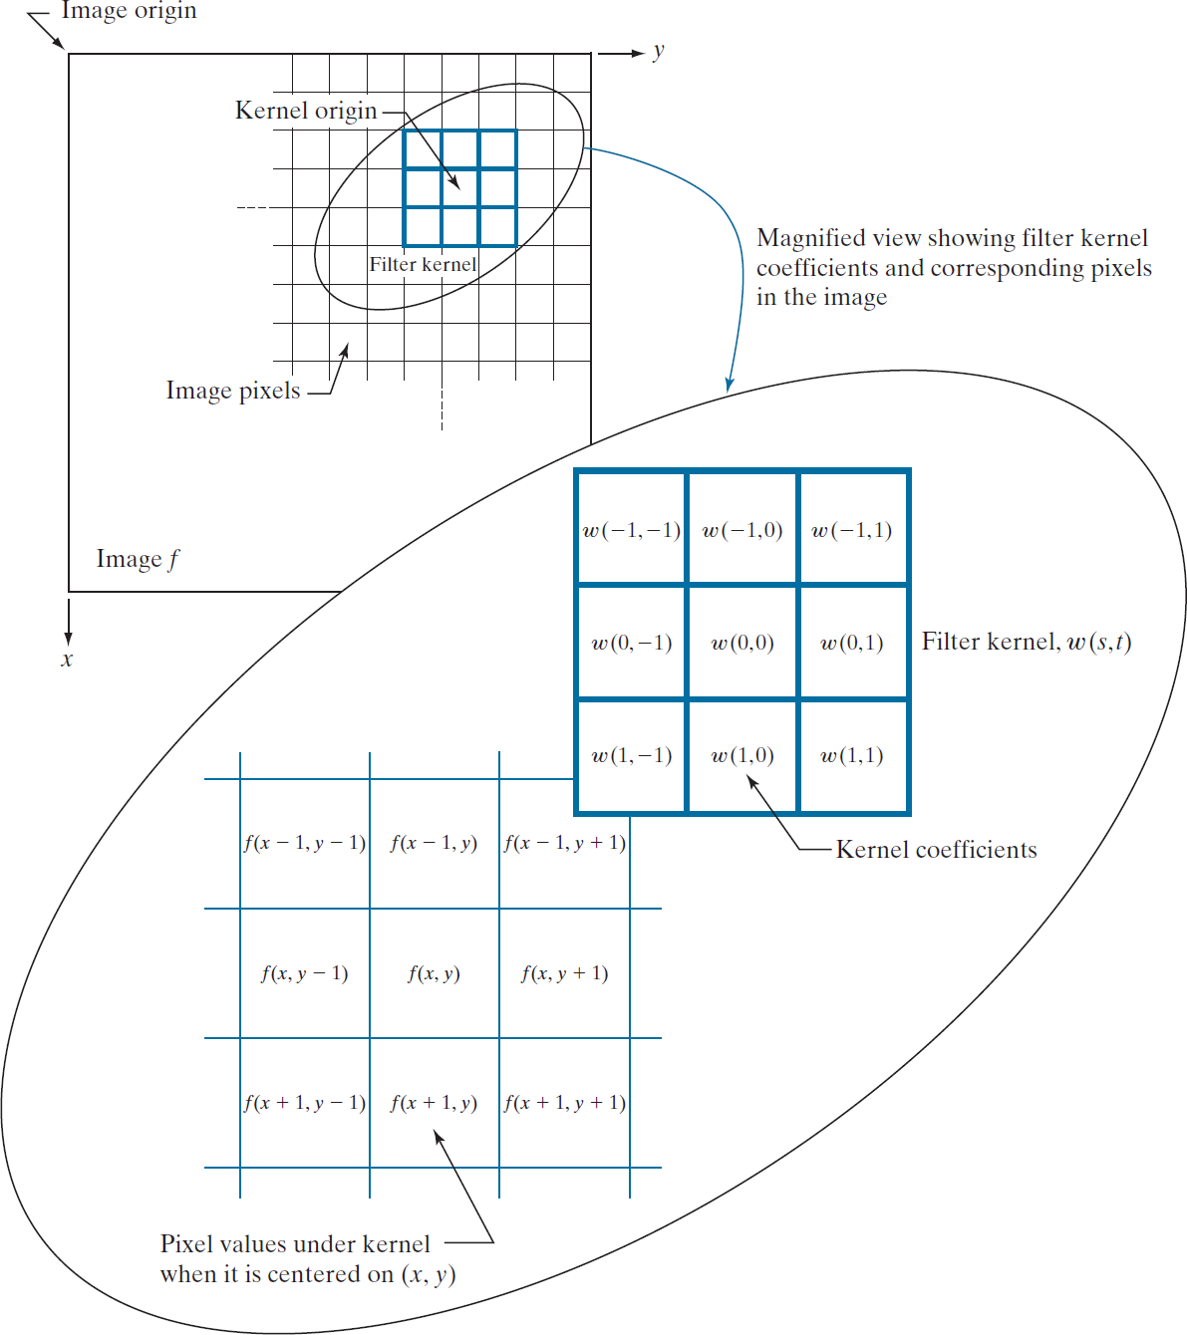
Fundamentals of Spatial Filtering
●
Two components in any spatial filter definition:
– A neighborhood
An operation defined in the neighborhood
–
●
Spatial Filtering:
– Linear spatial filters (e.g. mean)
Nonlinear spatial filters (e.g. median)
–

Slide 32
Linear Spatial Filtering
●
Sum-of-products operation between an image f and a filter kernel w.
The kernel is an array which defines the neighborhood of operation, and its
●
coefficients determine the nature of the filter.
A kernel is also called mask, template, and window. Assume a 3-by-3 kernel like the figure.
w (−1 ,−1) w (−1 , 0) w (−1 , 1)
w (0 ,−1) w (0 , 0) w (0 , 1)
w(1 ,−1) w (1 , 0) w(1 , 1)
●
●
●
At any point (x,y), the response, g(x,y), of the filter is the sum-of-products of the kernel coefficients and the image pixels encompassed by the kernel:
g ( x , y)=w (−1 ,−1) f ( x−1 , y−1)+w (−1,0) f ( x−1 , y )+...
+w (0,0) f ( x , y)+...+w (1,1) f ( x+1 , y +1)
As the coordinates (x,y) change, the center of the kernel moves from pixel to pixel, generating the filtered image g.
●

Slide 33
Linear Spatial Filtering
●
The center coefficient of the kernel, w(0,0), aligns with the pixel at location
(x,y).
A generalized kernel of size (mxn), with m=2a+1 and n=2b+1, where a and b are non-negative integers, can be applied to the image to create the filtered image g(x,y) such as:
●
a b
g ( x , y)= ∑ ∑ w (s , t ) f ( x+s, y+t )
s=−a t =−b
where x and y are changed so the center of the kernel goes through every pixel in image f once.

Slide 34

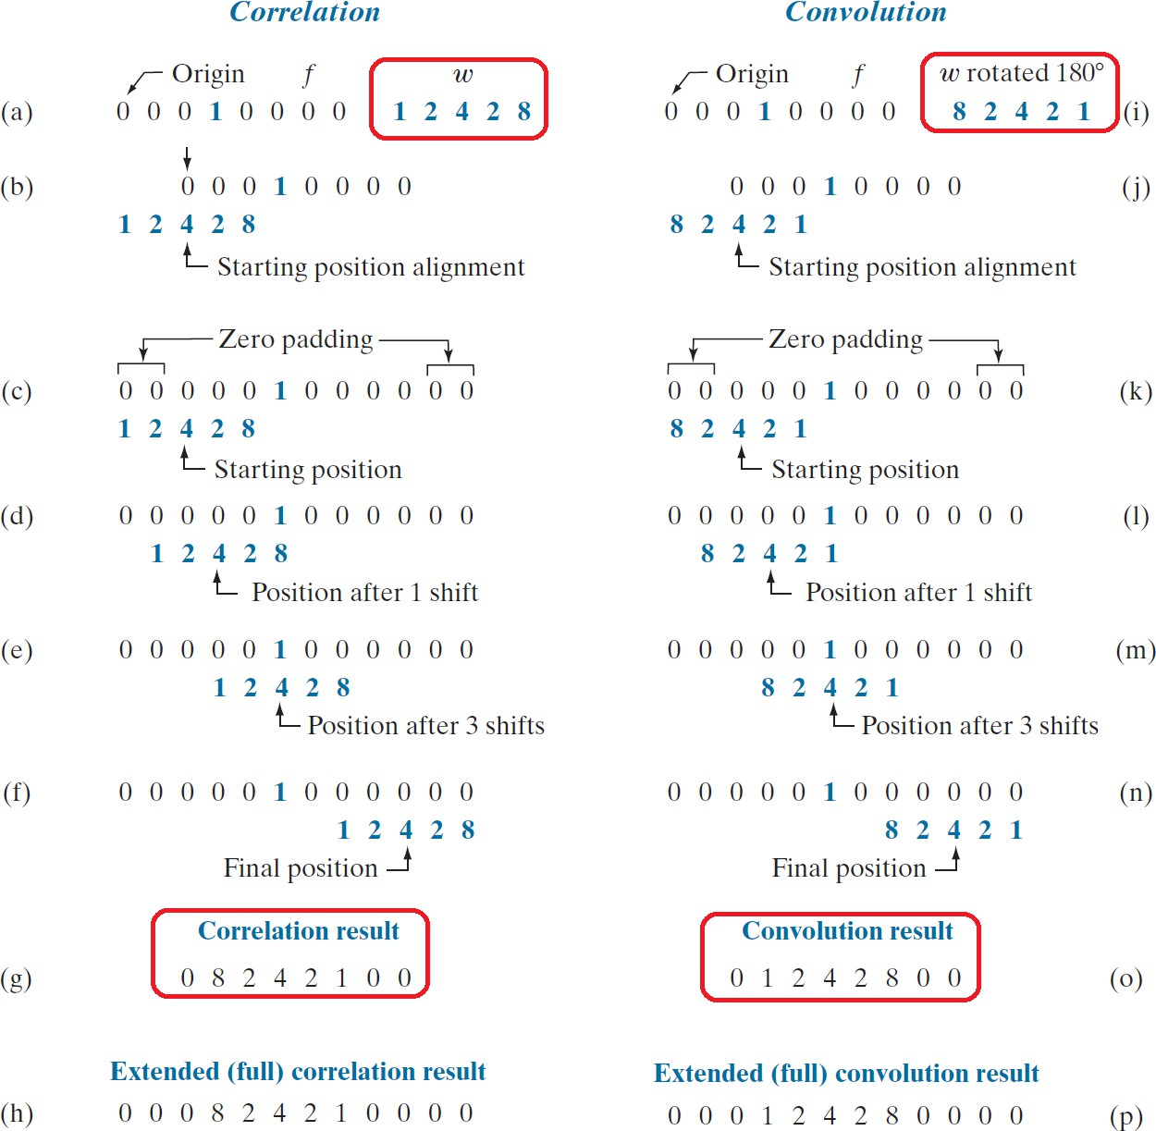

Correlation vs. Convolution: 1D Case
●
Correlation: (also shown with )
a
(w⊕f )( x)= ∑ w (s) f ( x+s)
s=−a
●
Convolution: (also shown with )
a
(w⊗f )( x)= ∑ w (s) f ( x−s )
s=−a
●
Function f is a discrete unit impulse.
{
if x=x₀
0 otherwise
δ ( x− x )=
1
0
●
Pre-rotating the kernel results in an exact copy of the kernel.
Linear spatial filtering and spatial convolution are synonymous.
●

Slide 35
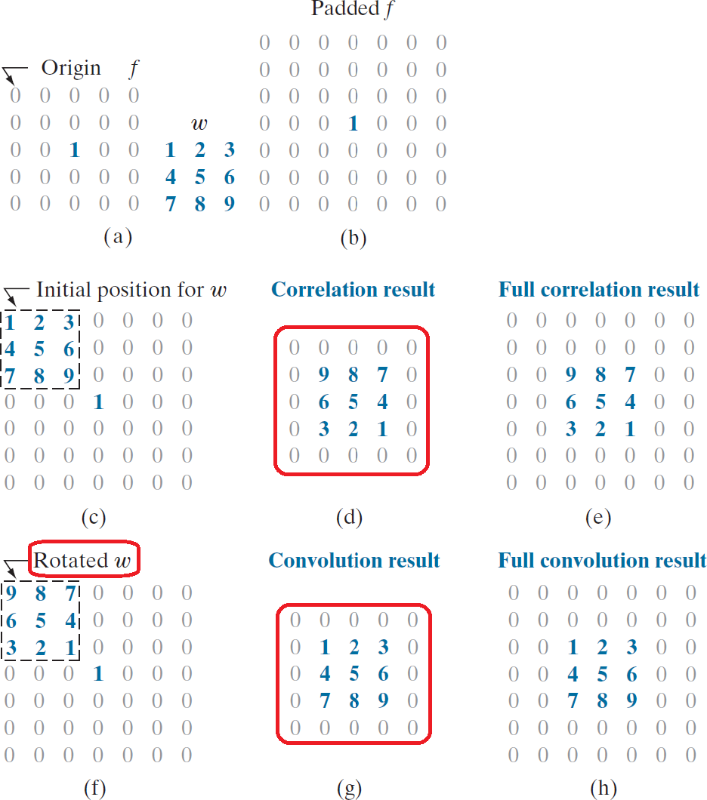
Correlation vs. Convolution: 2D Case
The same can be said about 2D case. Correlation:
●
●
a b
(w⊕f )(x , y )= ∑ ∑ w ( s , t ) f ( x+s, y +t )
s=−a t =−b
●
Convolution:
a b
(w⊗f )(x , y )= ∑ ∑ w ( s , t ) f ( x−s, y −t )
s=−a t =−b
●
Function f is a discrete unit impulse.
{
δ ( x− x , y− y )=
1 if x=x₀ and y= y₀
0 otherwise
0 0
●
Pre-rotating the kernel results in an exact copy of the kernel.
Linear spatial filtering and spatial convolution are synonymous.
●
33 / 41

Slide 36
Correlation vs. Convolution: Properties
Properties | Convolution | Correlation
Commutative | f ⊗g=g⊗f | -
Associative | f ⊗(g⊗h)=(f ⊗g)⊗h | -
Distributive | f ⊗(g +h)=(f ⊗g)+(f ⊗h) | f ⊕(g+h)=(f ⊕g)+(f ⊕h)
●
Because of the commutative property of convolution, it is not important whether the kernel or the image is pre-rotated.
Also, performing multistage filtering is possible, if the kernels are convolved first, and the resulting kernel is applied to the image.
w=w₁⊗w₂⊗...⊗w _{N}
●
34 / 41

